Slide 1
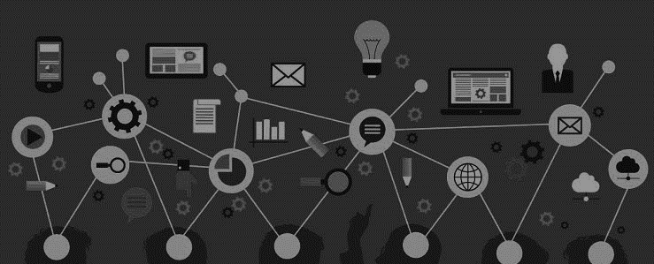
Green Energy from Human Motion:
A Piezoelectric Solution for Vikasit Bharat
Theme: Renewable Energy Resources
Team Name: GreenStep

Slide 2
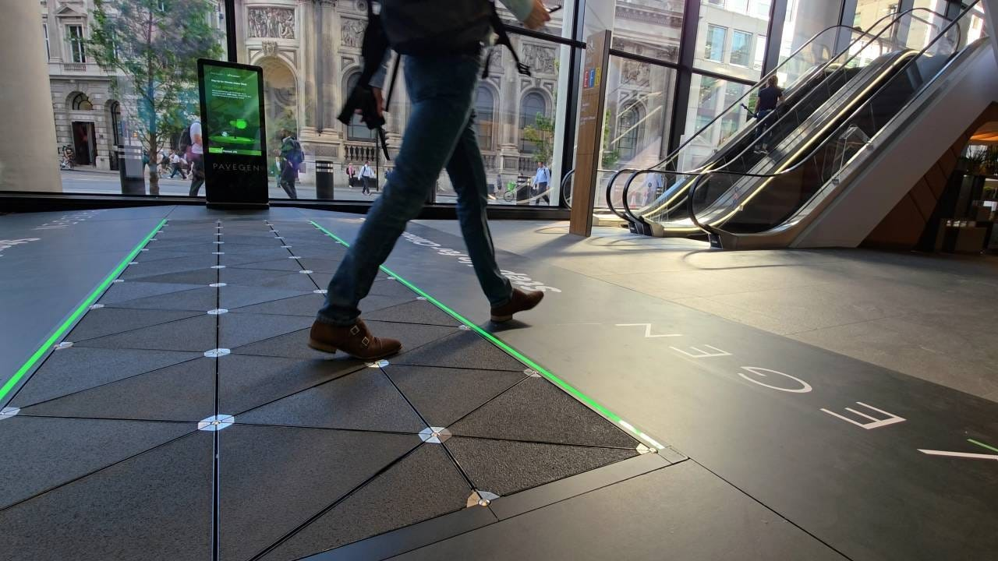
1. The Overview: Piezoelectric Floor Tiles
Turning Every Step into Sustainable Electric Energy
Who we are:
We are a team dedicated to make a Piezoelectric Floor Tile Energy Harvester that converts everyday human movement into useful electrical energy. Our mission is to utilize the mechanical energy generated from footsteps in crowded public spaces and transform it into a clean and sustainable power source. By focusing on simplicity, affordability, and practical implementation, we aim to reduce energy wastage and support smart, eco-friendly infrastructure solutions.
LEARN NOW

Slide 3
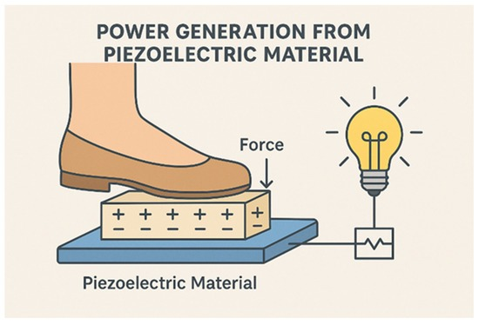
2. The Problem
What problem are you trying to solve? Is it really a problem?
-Large amounts of footstep energy are wasted daily in public spaces.
Description of customer pain points
High energy wastage Rising electricity demand Dependence on conventional power Limited renewable options in public spaces
What kind of person/customer is this product for? - Persona :
Railway stations & Bus terminals
Shopping malls
Airports
Educational institutions
Public & Government buildings
How the innovation solves it - concept & key elements :
Footsteps generate electricity.
Stored in batteries.
Powers lights/devices.
Saves grid power.
LEARN NOW

Slide 4
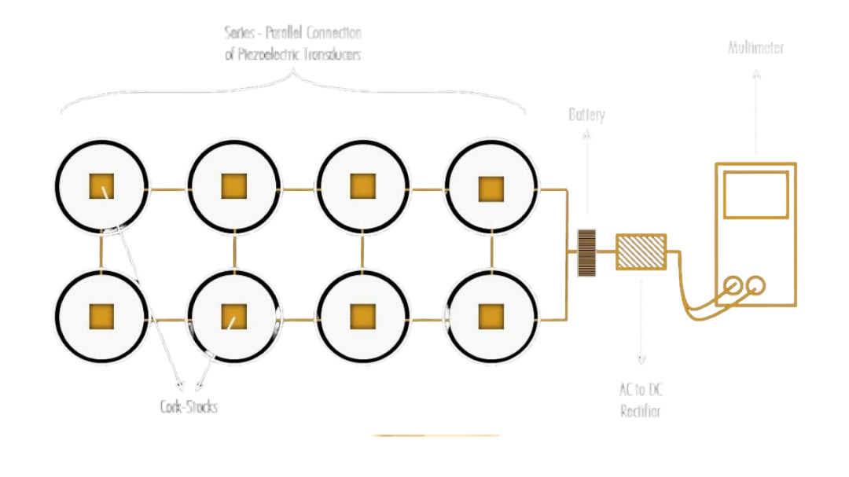
3.The Solution
What the innovation does :
Our Piezoelectric Floor Tile System harvests energy from human footsteps and converts it into electricity. It is designed to be efficient, durable, and suitable for public spaces like malls, stations, and offices.
Features:
Converts footsteps into usable electricity and stores it safely
Powers LEDs, sensors, and small devices
Durable and easy to install in high-footfall areas
Why it’s compelling :
Our solution bridges this gap by providing a sustainable and cost-effective way to generate electricity from footsteps. It is durable, energy-efficient, and can be easily installed in public spaces and high-traffic areas.
LEARN NOW
Include explainer videos, demos, product screenshots if any
https://youtu.be/YZ4OBxyyqOg?si=bcKz9o7-9FmDvqPp

Slide 5
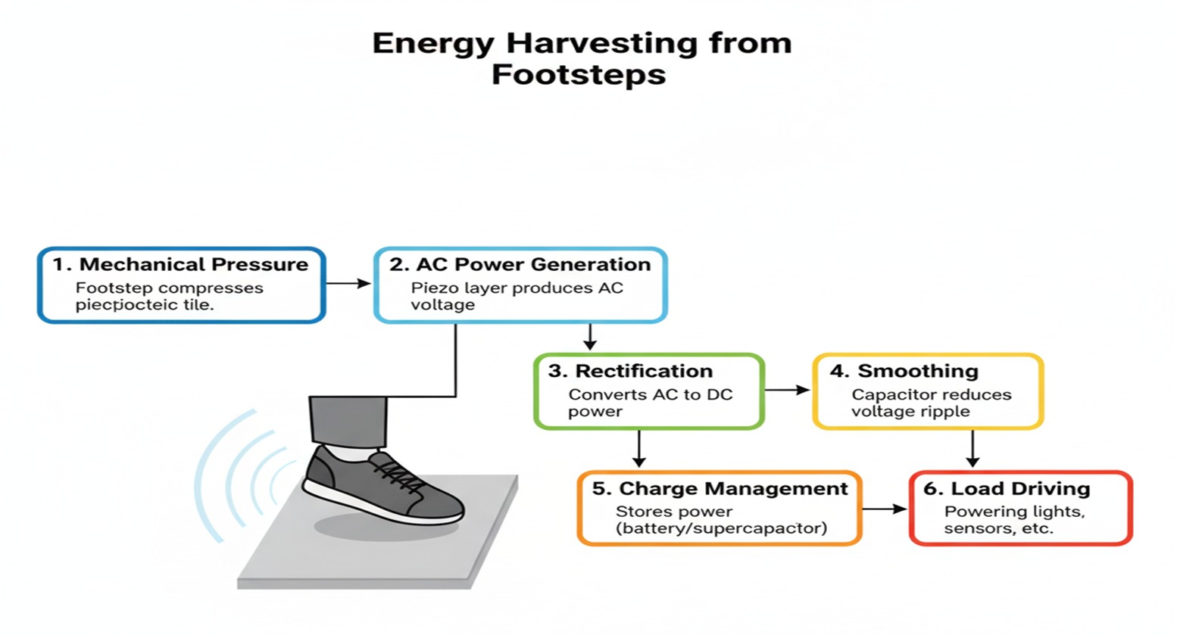
4. The innovation
Value Proposition of product/service :
Energy generation from everyday human movement
Modular tile-based design
No fuel, no emissions, no pollution
Works continuously in crowded areas
Benefits/Impact will be created :
Clean and renewable energy generation
Reduced electricity costs
Supports smart city initiatives
Encourages sustainable living
Efficient utilization of wasted energy
LEARN NOW
POC Video :
https://drive.google.com/file/d/11yjVr5r_Jtw9HyfuuD8DnmPXptCE4yhQ/view?usp=drivesdk

Slide 6
5. Market & Opportunity
Total Addressable Market:
Global smart city and renewable energy infrastructure Includes all commercial & public buildings
Driven by sustainability and energy-efficiency needs
Serviceable Addressable Market (SAM)
High-footfall public spaces (malls, airports, metros) Smart buildings and government projects Urban and semi-urban deployment focus
Target Market - The portion of SAM that you can capture :
Primary/Secondary Research Data :
Primary Research: Surveys, interviews, or observations from potential users in smart buildings, malls, and campuses.
Secondary Research: Industry reports, market studies, and published data on energy harvesting adoption and trends.
LEARN NOW

Slide 7
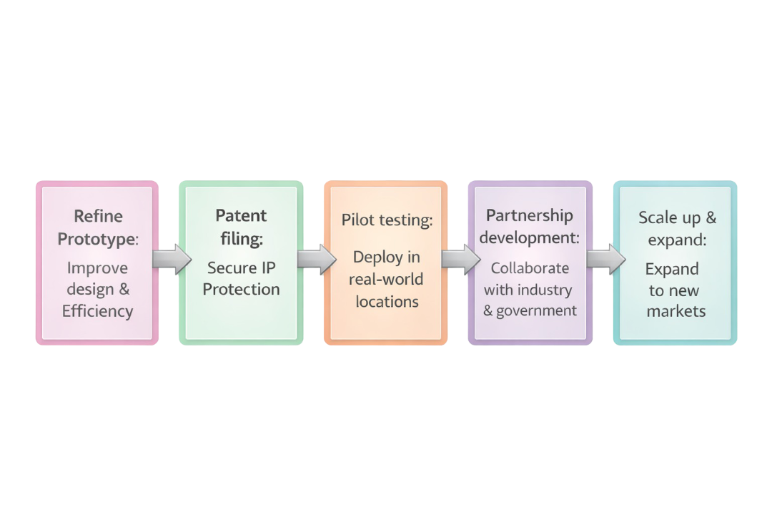
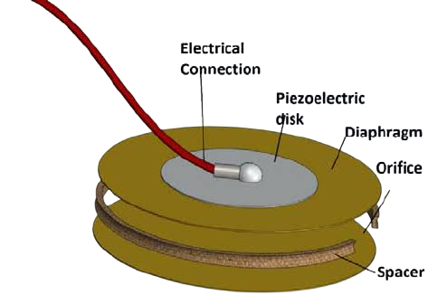
6. The Technology/Innovation
Development of Solution and TRL:
The solution is in the prototype/early-stage development phase at TRL 3–4, with piezoelectric sensors and power storage components tested in relevant environments for energy generation and efficiency.
Intellectual Property & Innovation:
Unique integration of piezoelectric tiles with energy storage
Microcontroller-based monitoring for optimized power management
Optional IoT-enabled smart energy applications
Scalable design for high-footfall areas
Road Map for going forward:
LEARN NOW

Slide 8
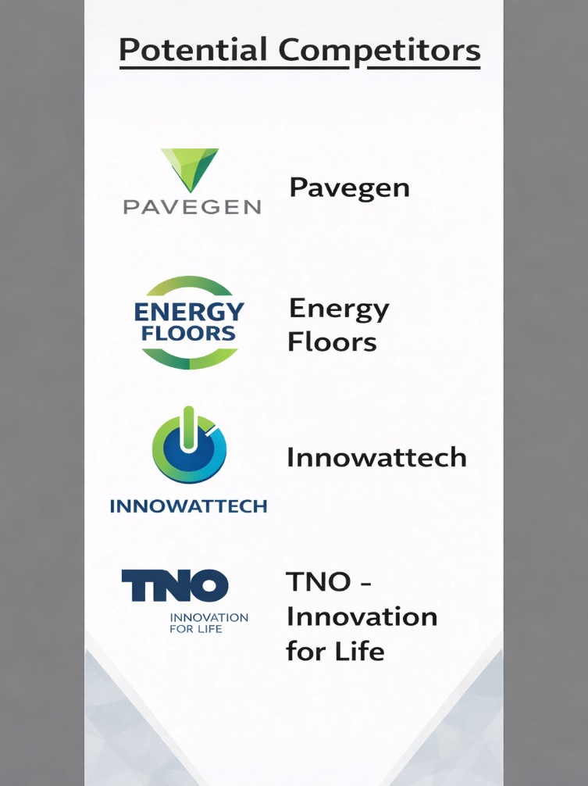
7. Competitive Landscape
Uniqueness:
Generates power from footsteps anywhere.
Works indoors and outdoors, anytime.
Competitive Advantages:
Works indoors & outdoors
Independent of weather conditions
Low maintenance
Uses human activity as energy source
Barriers to entry – Key partnerships, IP Opportunities for collaboration and co-creation:
Barriers: Technical integration, system design know-how Partnerships: Smart city bodies, infrastructure & IoT firms IP Opportunities and Co-operation: Research collaborations with academic institutions
LEARN NOW

Slide 9
8. LEAN CANVAS
Footstep energy wasted in public places
Rising demand for renewable energy
High dependence on grid power
Piezoelectric tiles generate electricity
Pressure from footsteps used
Energy stored for later use
Airports and railway stations
Malls and commercial buildings
Schools and smart cities
Clean and renewable energy
No extra space required
Ideal for smart infrastructure
Optimized piezo disc placement
Modular tile design
Low maintenance system
.
Grid electricity
Solar power systems
Battery-powered devices
Energy per footstep
System efficiency
Installation cost
Footsteps to electricity
Smart energy floor
Green infrastructure
Government projects
Infrastructure partners
Direct B2B sales
Smart city pilots
High-footfall spaces
Green buildings
LEARN NOW
Piezoelectric discs
Tile materials
Power electronics
Installation & maintenance
Tile system sales
Installation services
Maintenance contracts

Slide 10
9. Business Model
Source of Revenue:
Tile Sales: Selling piezoelectric floor tiles to institutions and public spaces Services: Installation, integration, and maintenance Custom Solutions: Tailored smart city and IoT applications
Viability:
Earns through: Tile sales, installation, and smart city solutions Scalable: Modular design for any high-footfall space Profitable: Low-cost, low-maintenance, recurring revenue from services
LEARN NOW

Slide 11
10. The Team
Mentor: Dr .T. Sudheer Kumar
Team Members:
Bestha Lahari
Maddineni Pallavi
Chakkati Kiran Kumari
Guntupalli Nandini
Ch.L.Samyutha Chowdary
Team member’s history & Describe their specific role:
Our team consists of Electronics and Communication Engineering students working on embedded systems, sensors, and power electronics.
Under faculty mentorship, we design, integrate, and test a low-cost piezoelectric energy harvesting system.
Unique Value
Our team combines electronics, renewable energy concepts, and smart infrastructure innovation to address real-world energy challenges.
LEARN NOW

Slide 12
Thankyou

